Slide 1

Introduction to R and Rstudio
Megan Stodel

Slide 2
Overview

Slide 3
Introduction
Who am I and what am I trying to do?

Slide 4
Planned sessions
Intro to R and RStudio
Data visualisation with ggplot2
Data wrangling with data.table

Slide 5
R and Rstudio

Slide 6
Tell us about R
A language designed for statistical computing and graphical techniques
One of the most popular languages used in data science
Highly extensible through packages and user-defined functions
RStudio is the go-to integrated development environment (IDE) for R

Slide 7
Navigating Rstudio

Slide 8
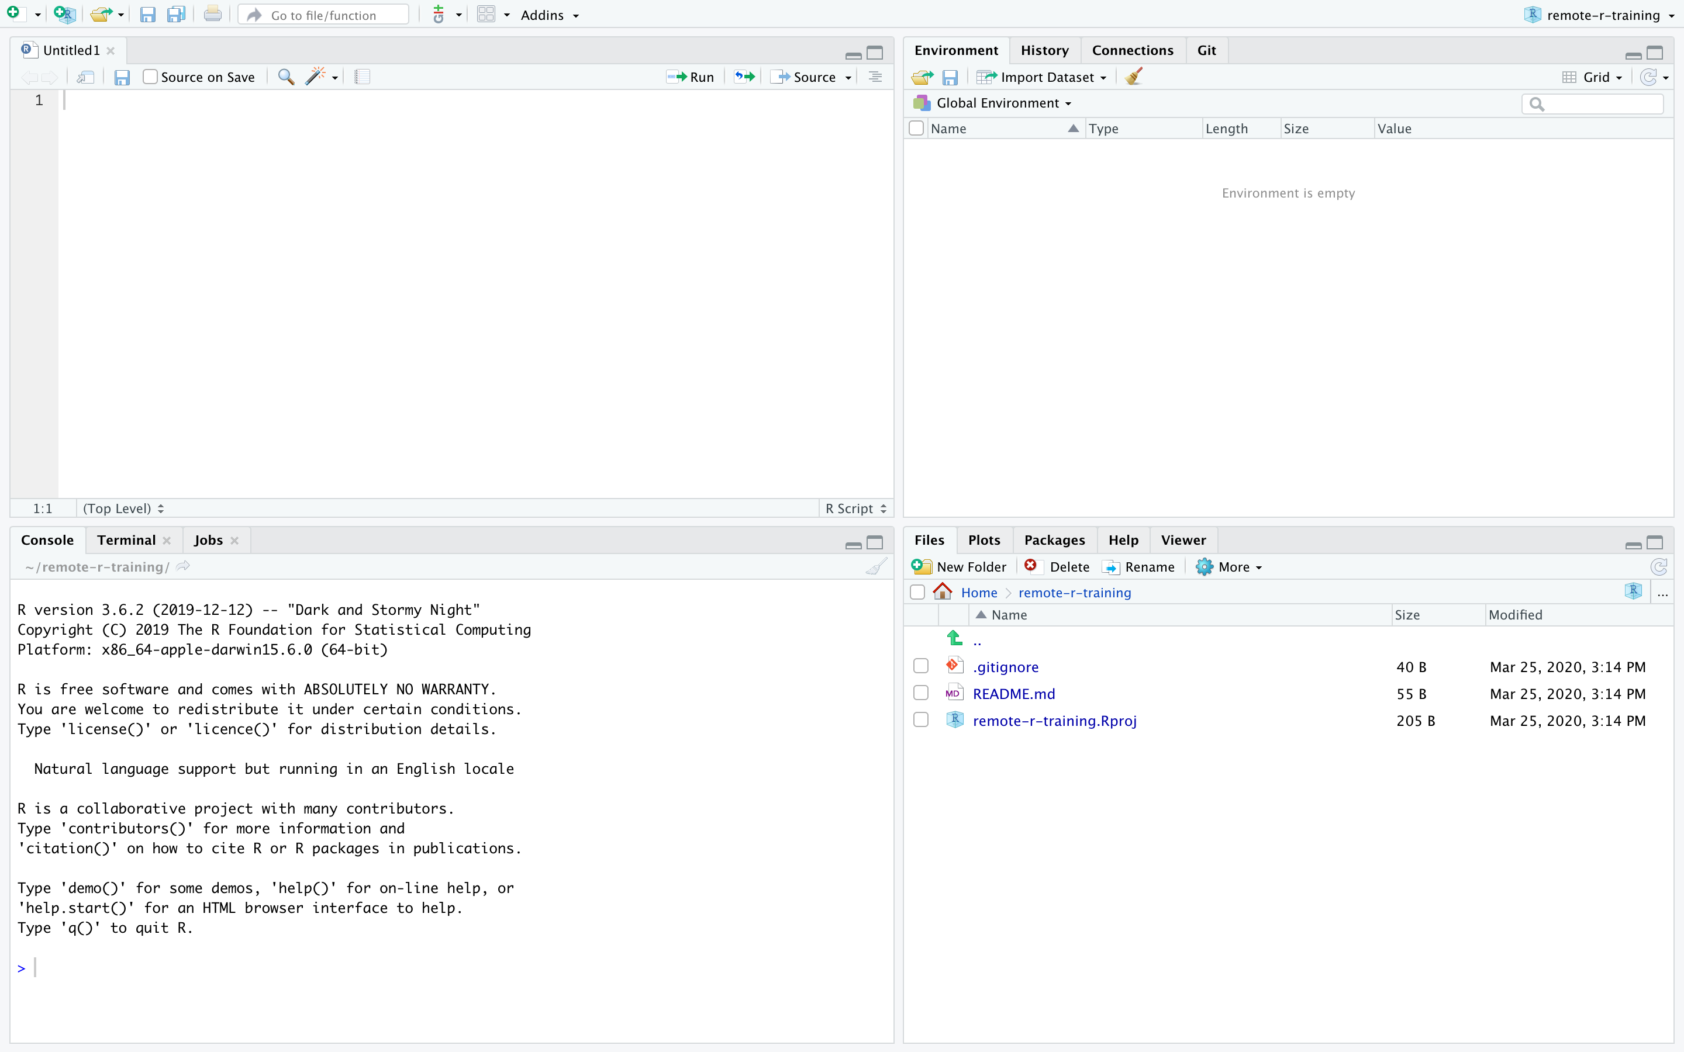
Source editor
(for scripts,
Rmarkdown, etc)
Environment Git
Console (running code
and seeing output
of running code)
Files
Packages
Plots/Viewer
Help

Slide 9
Packages

Slide 10
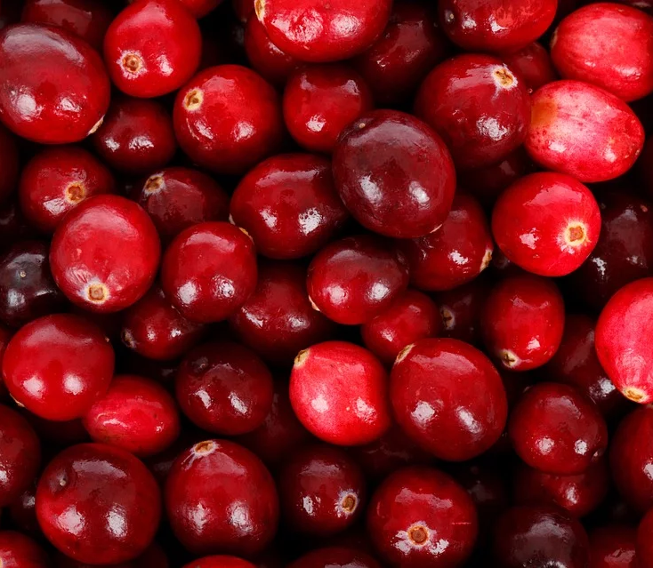
CRAN
The Comprehensive R Archive Network
15,495 packages (as of March 25, 2020)
“CRAN hosts packages of publication quality and is not a development platform. A package’s contribution has to be non-trivial.”

Slide 11
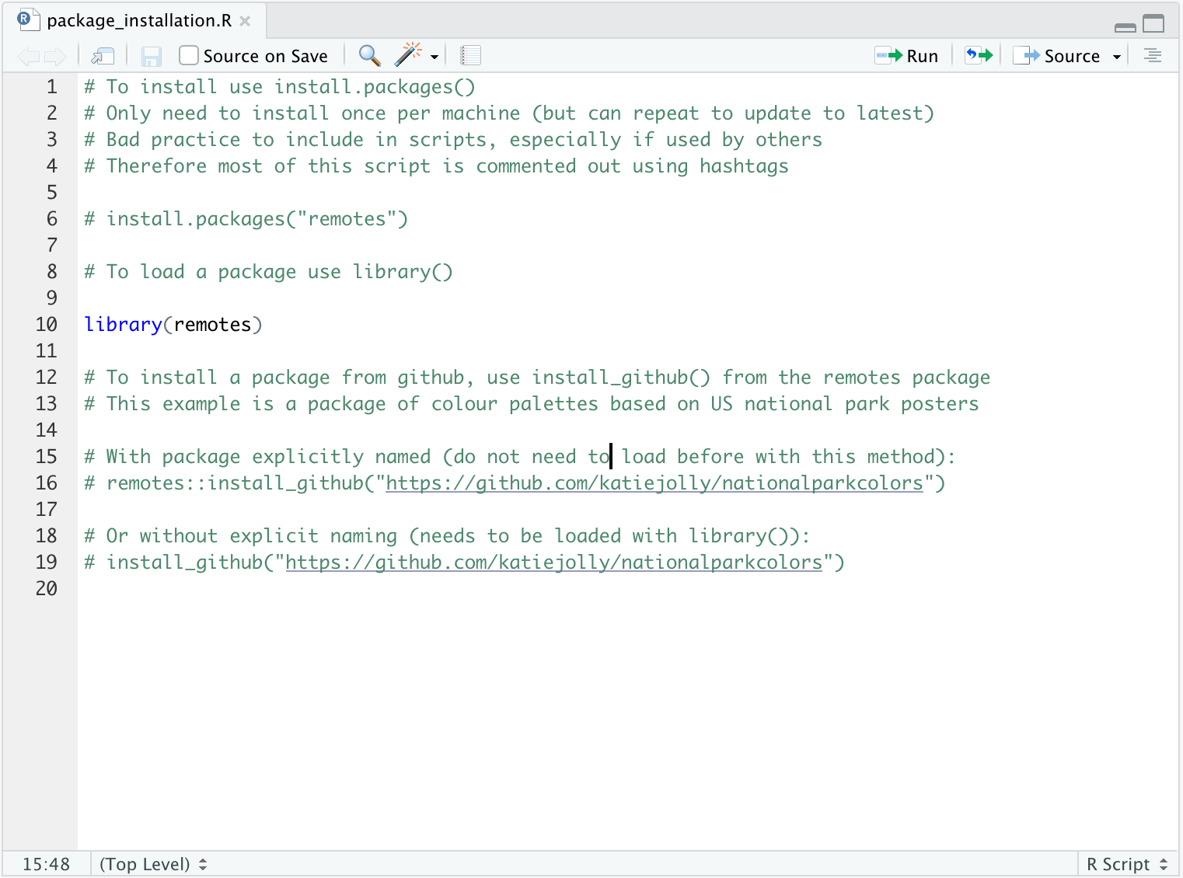

Slide 12
Reading in data

Slide 13
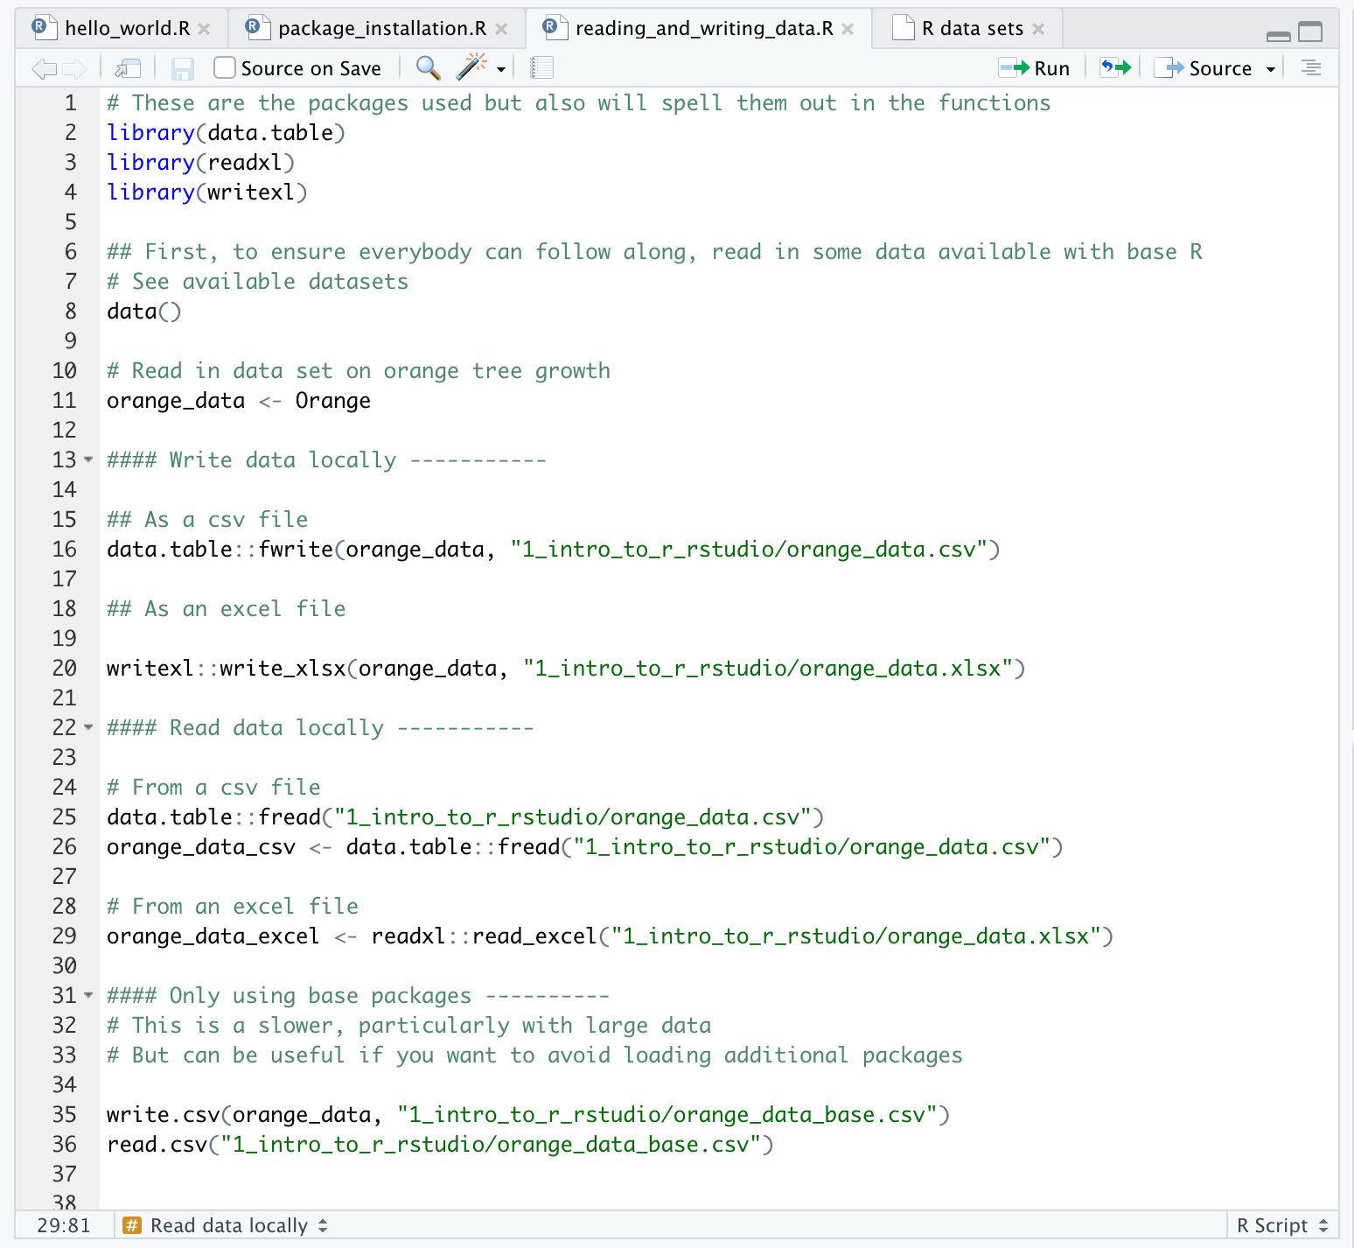

Slide 14
Starting a new project in github

Slide 15
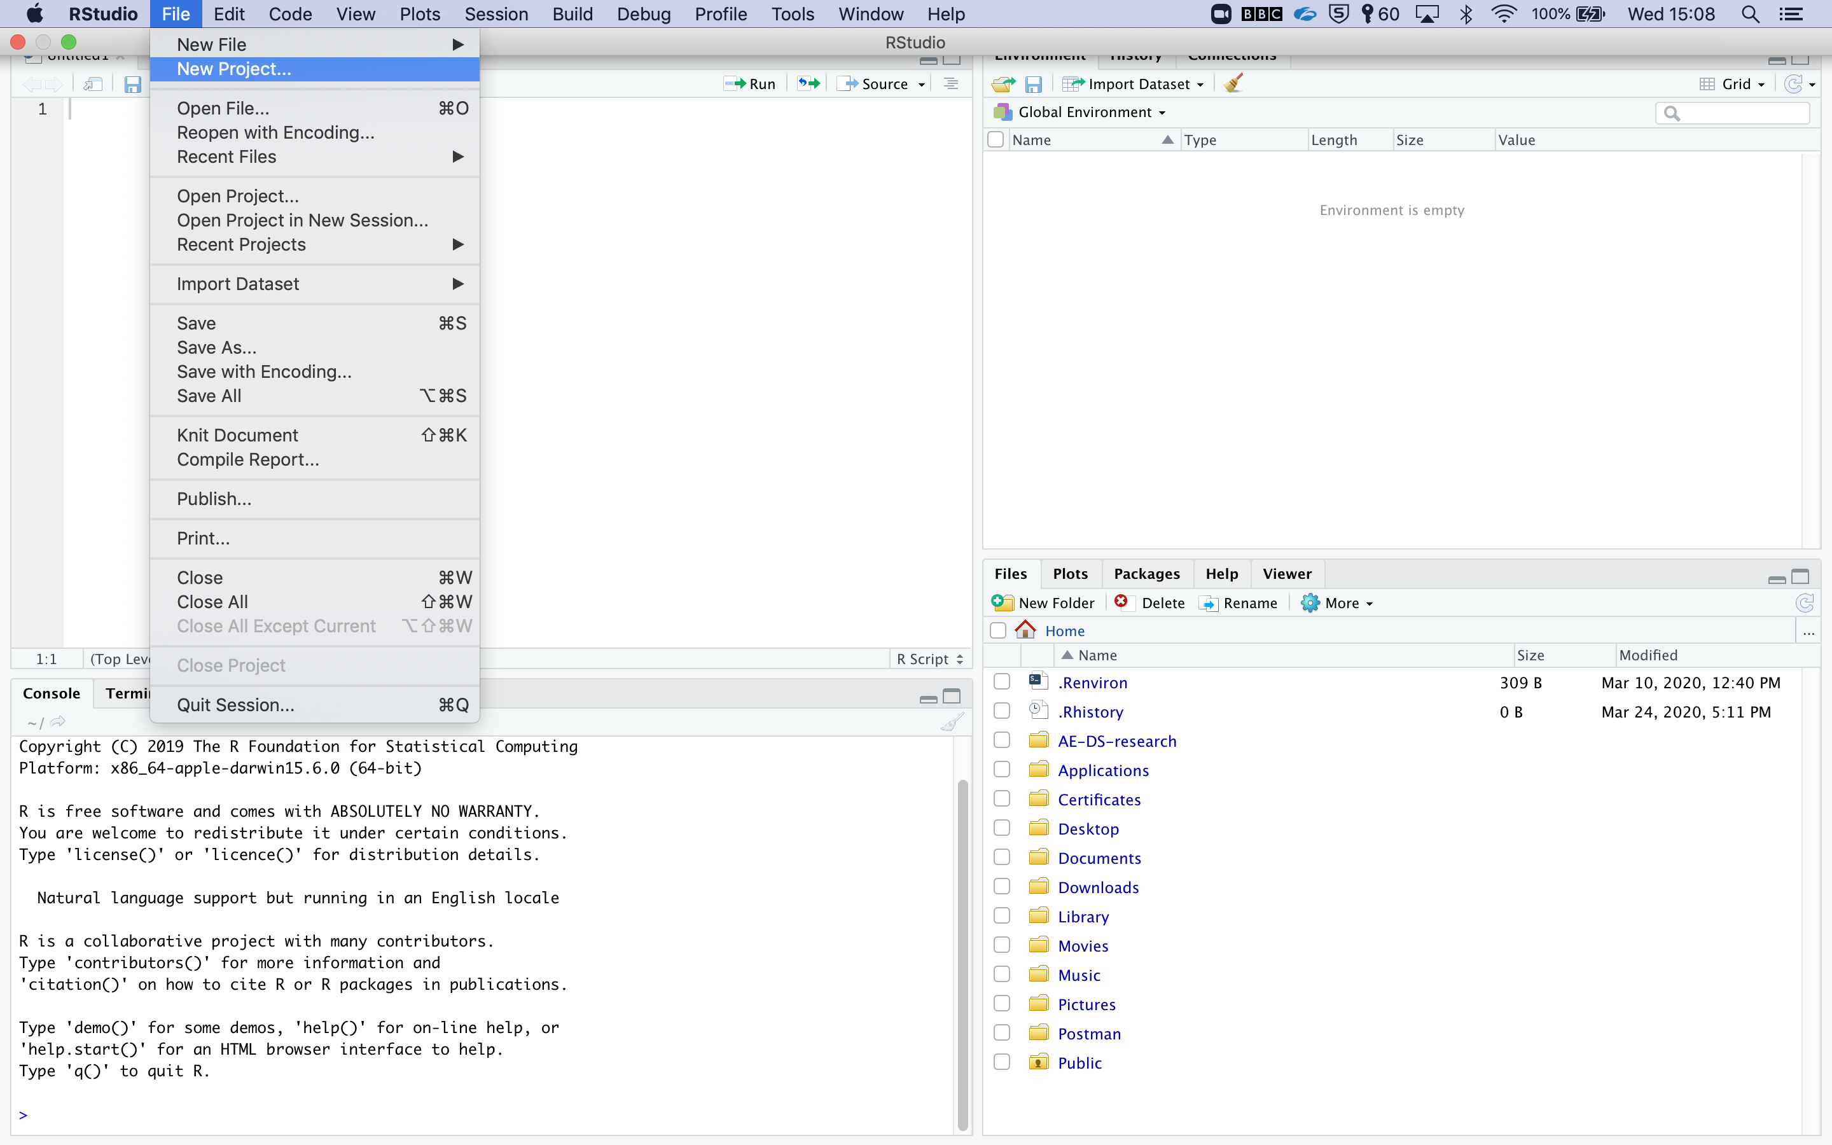

Slide 16
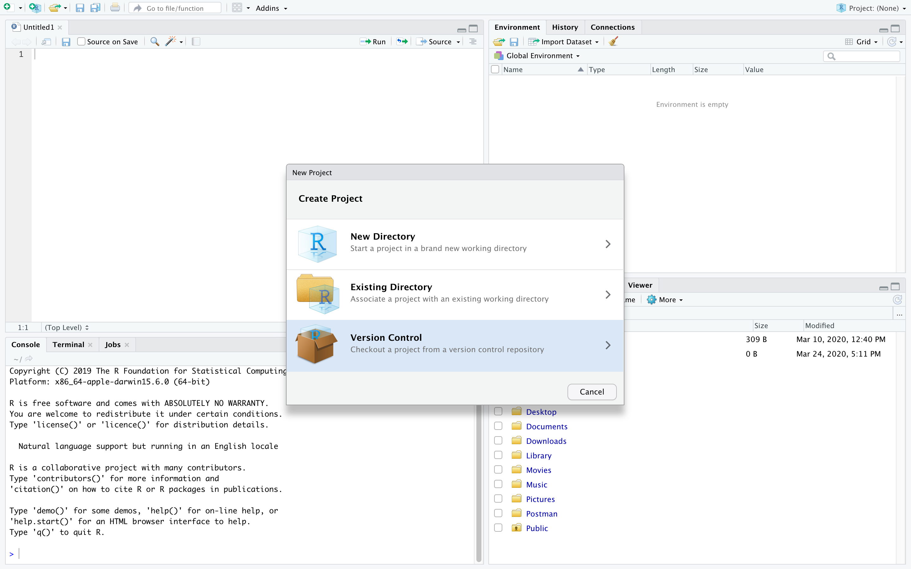

Slide 17
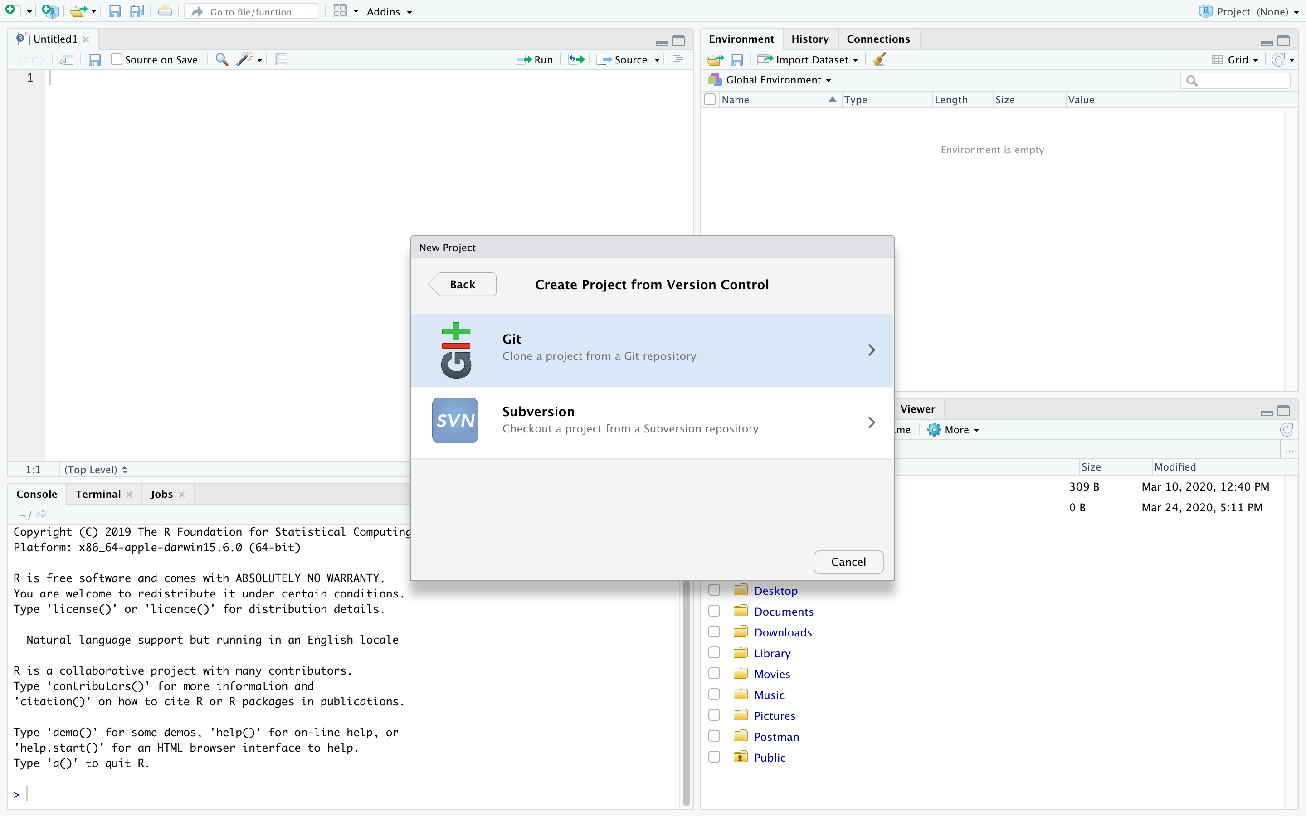

Slide 18
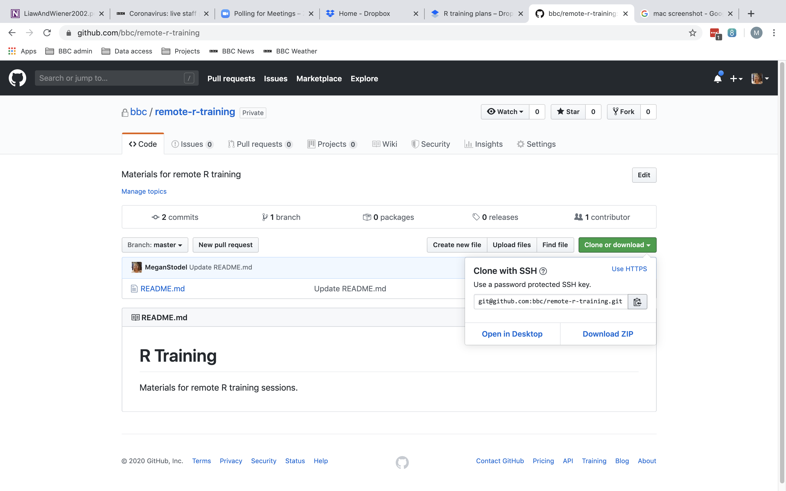

Slide 19
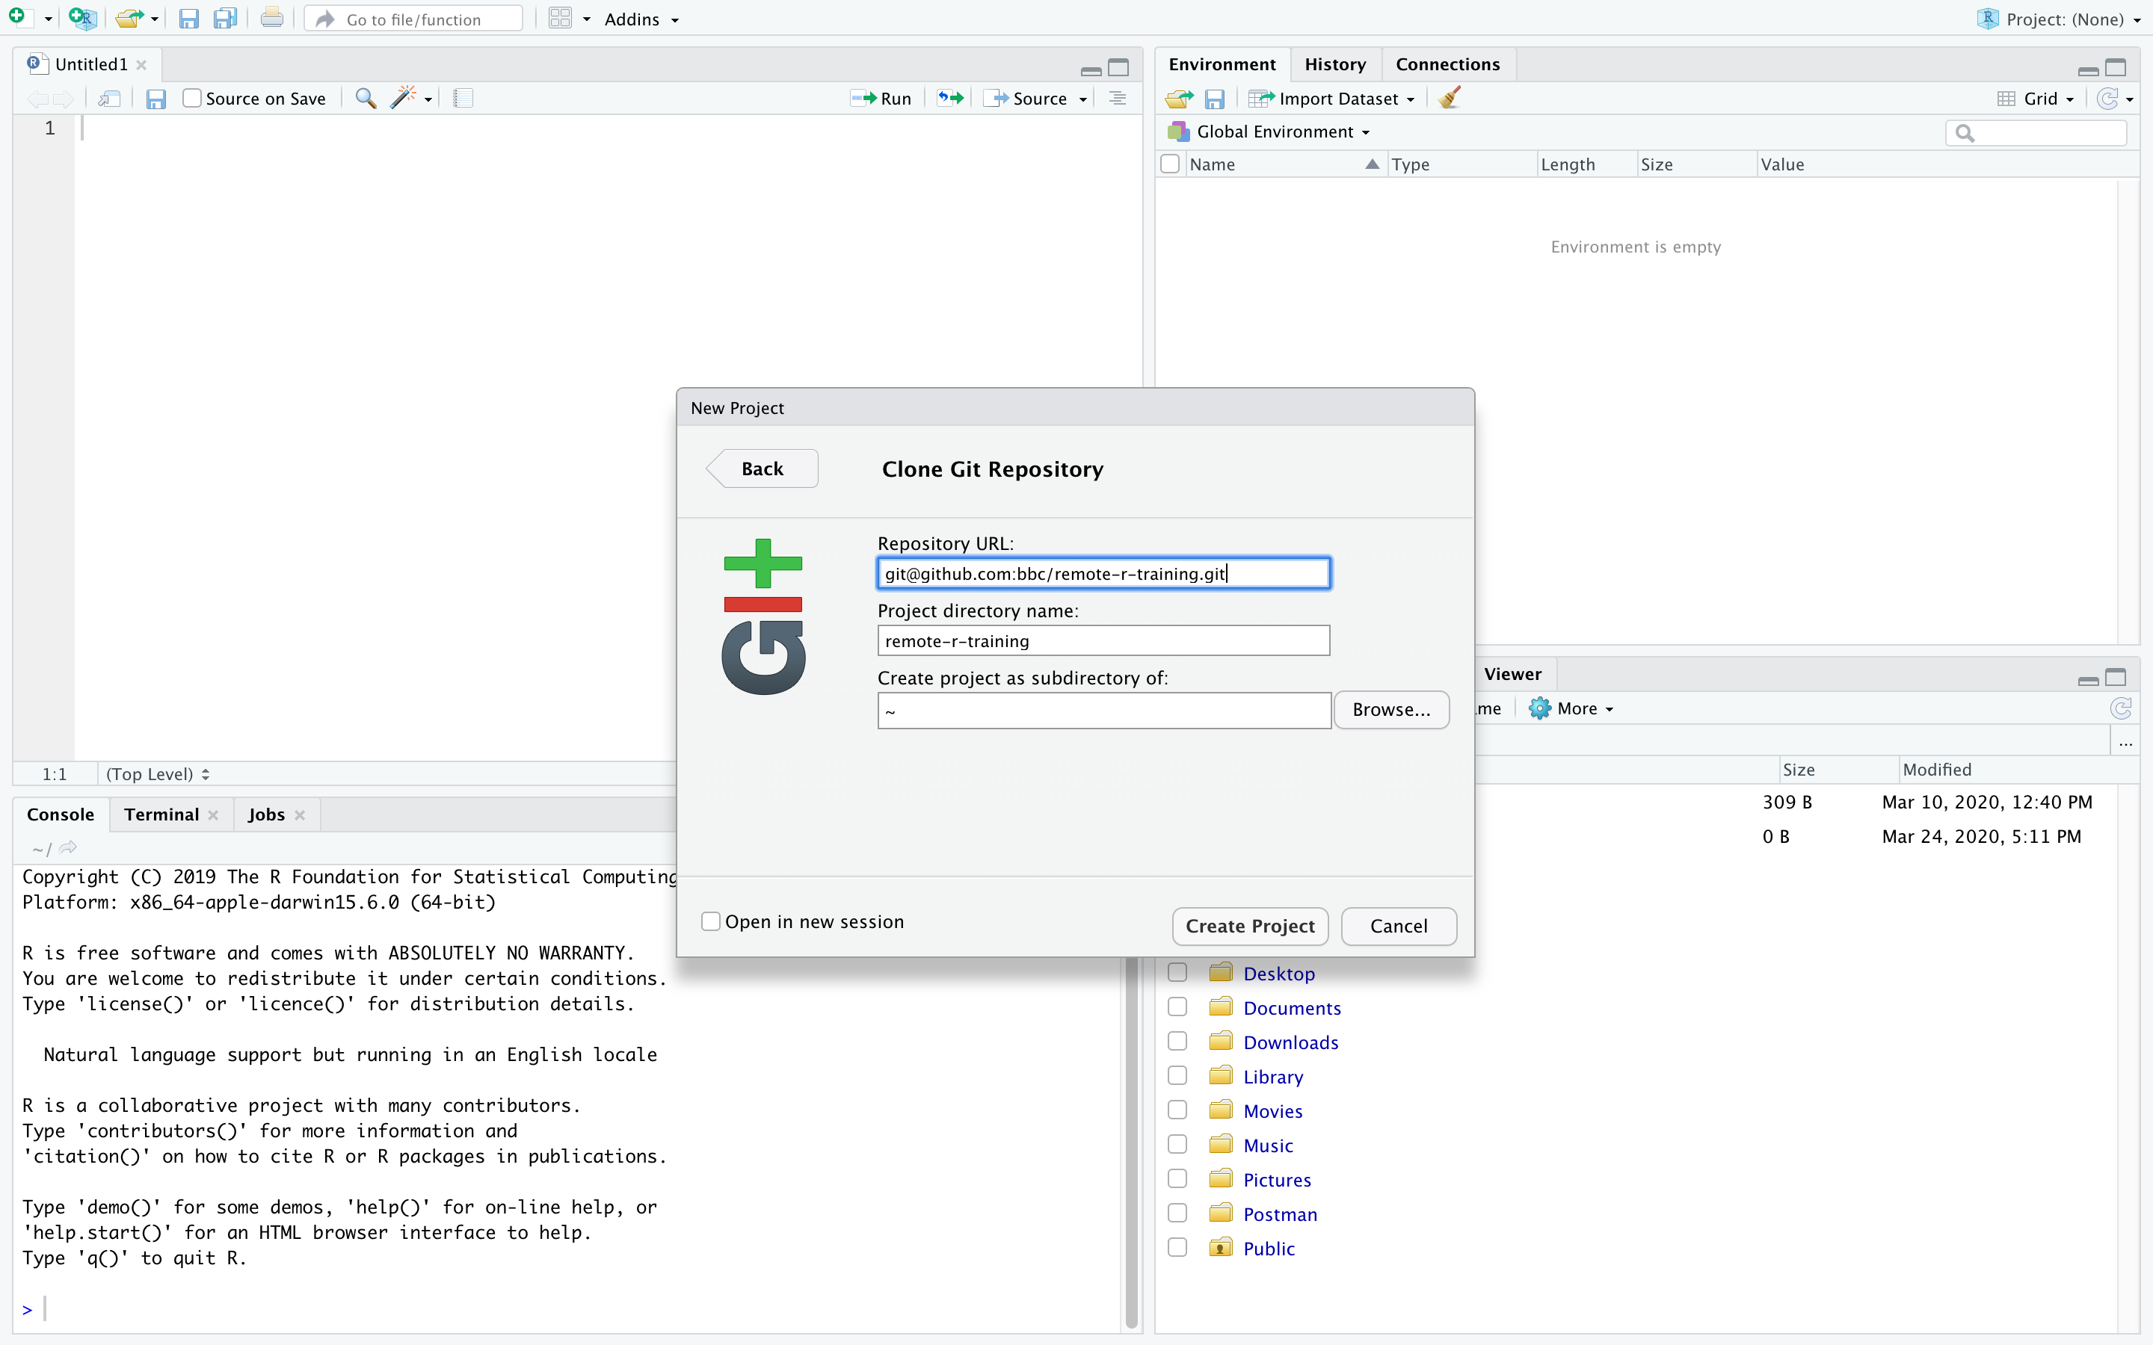

Slide 20
COMMITTING AND PUSHING CHANGES TO GITHUB

Slide 21
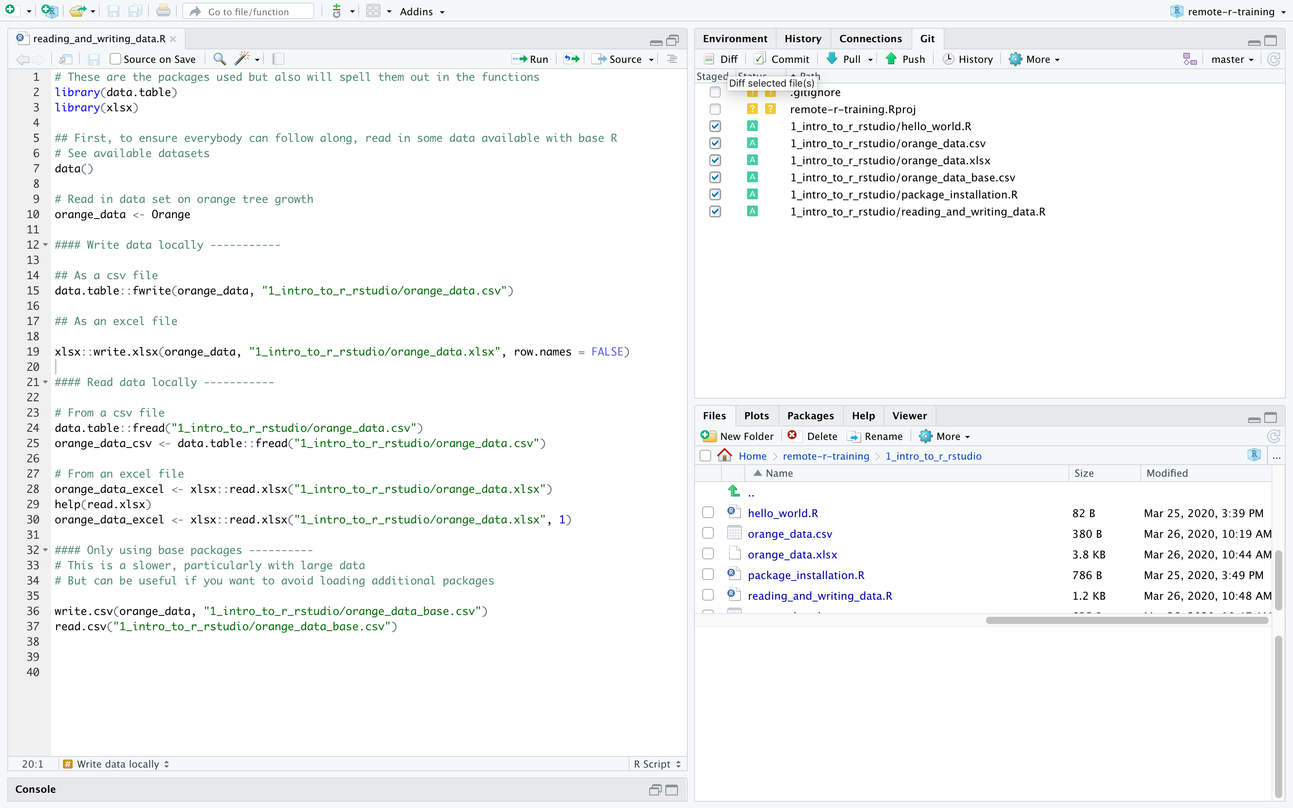

Slide 22
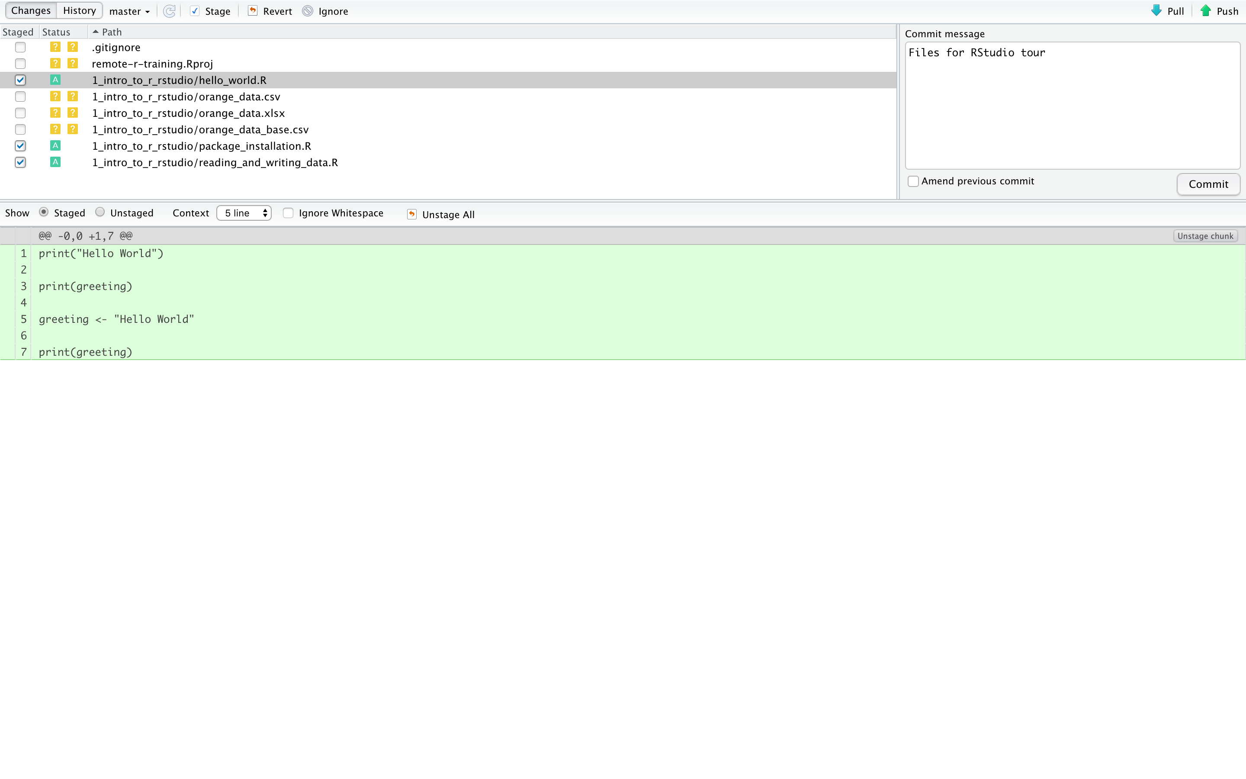

Slide 23
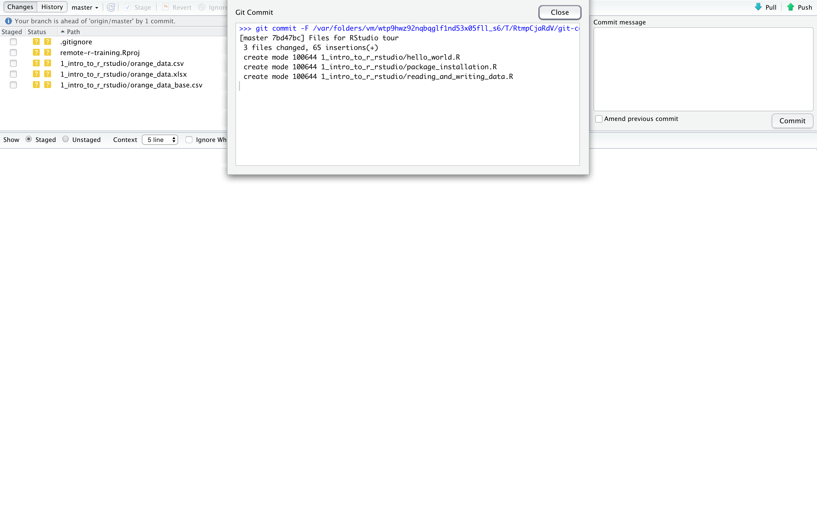

Slide 24
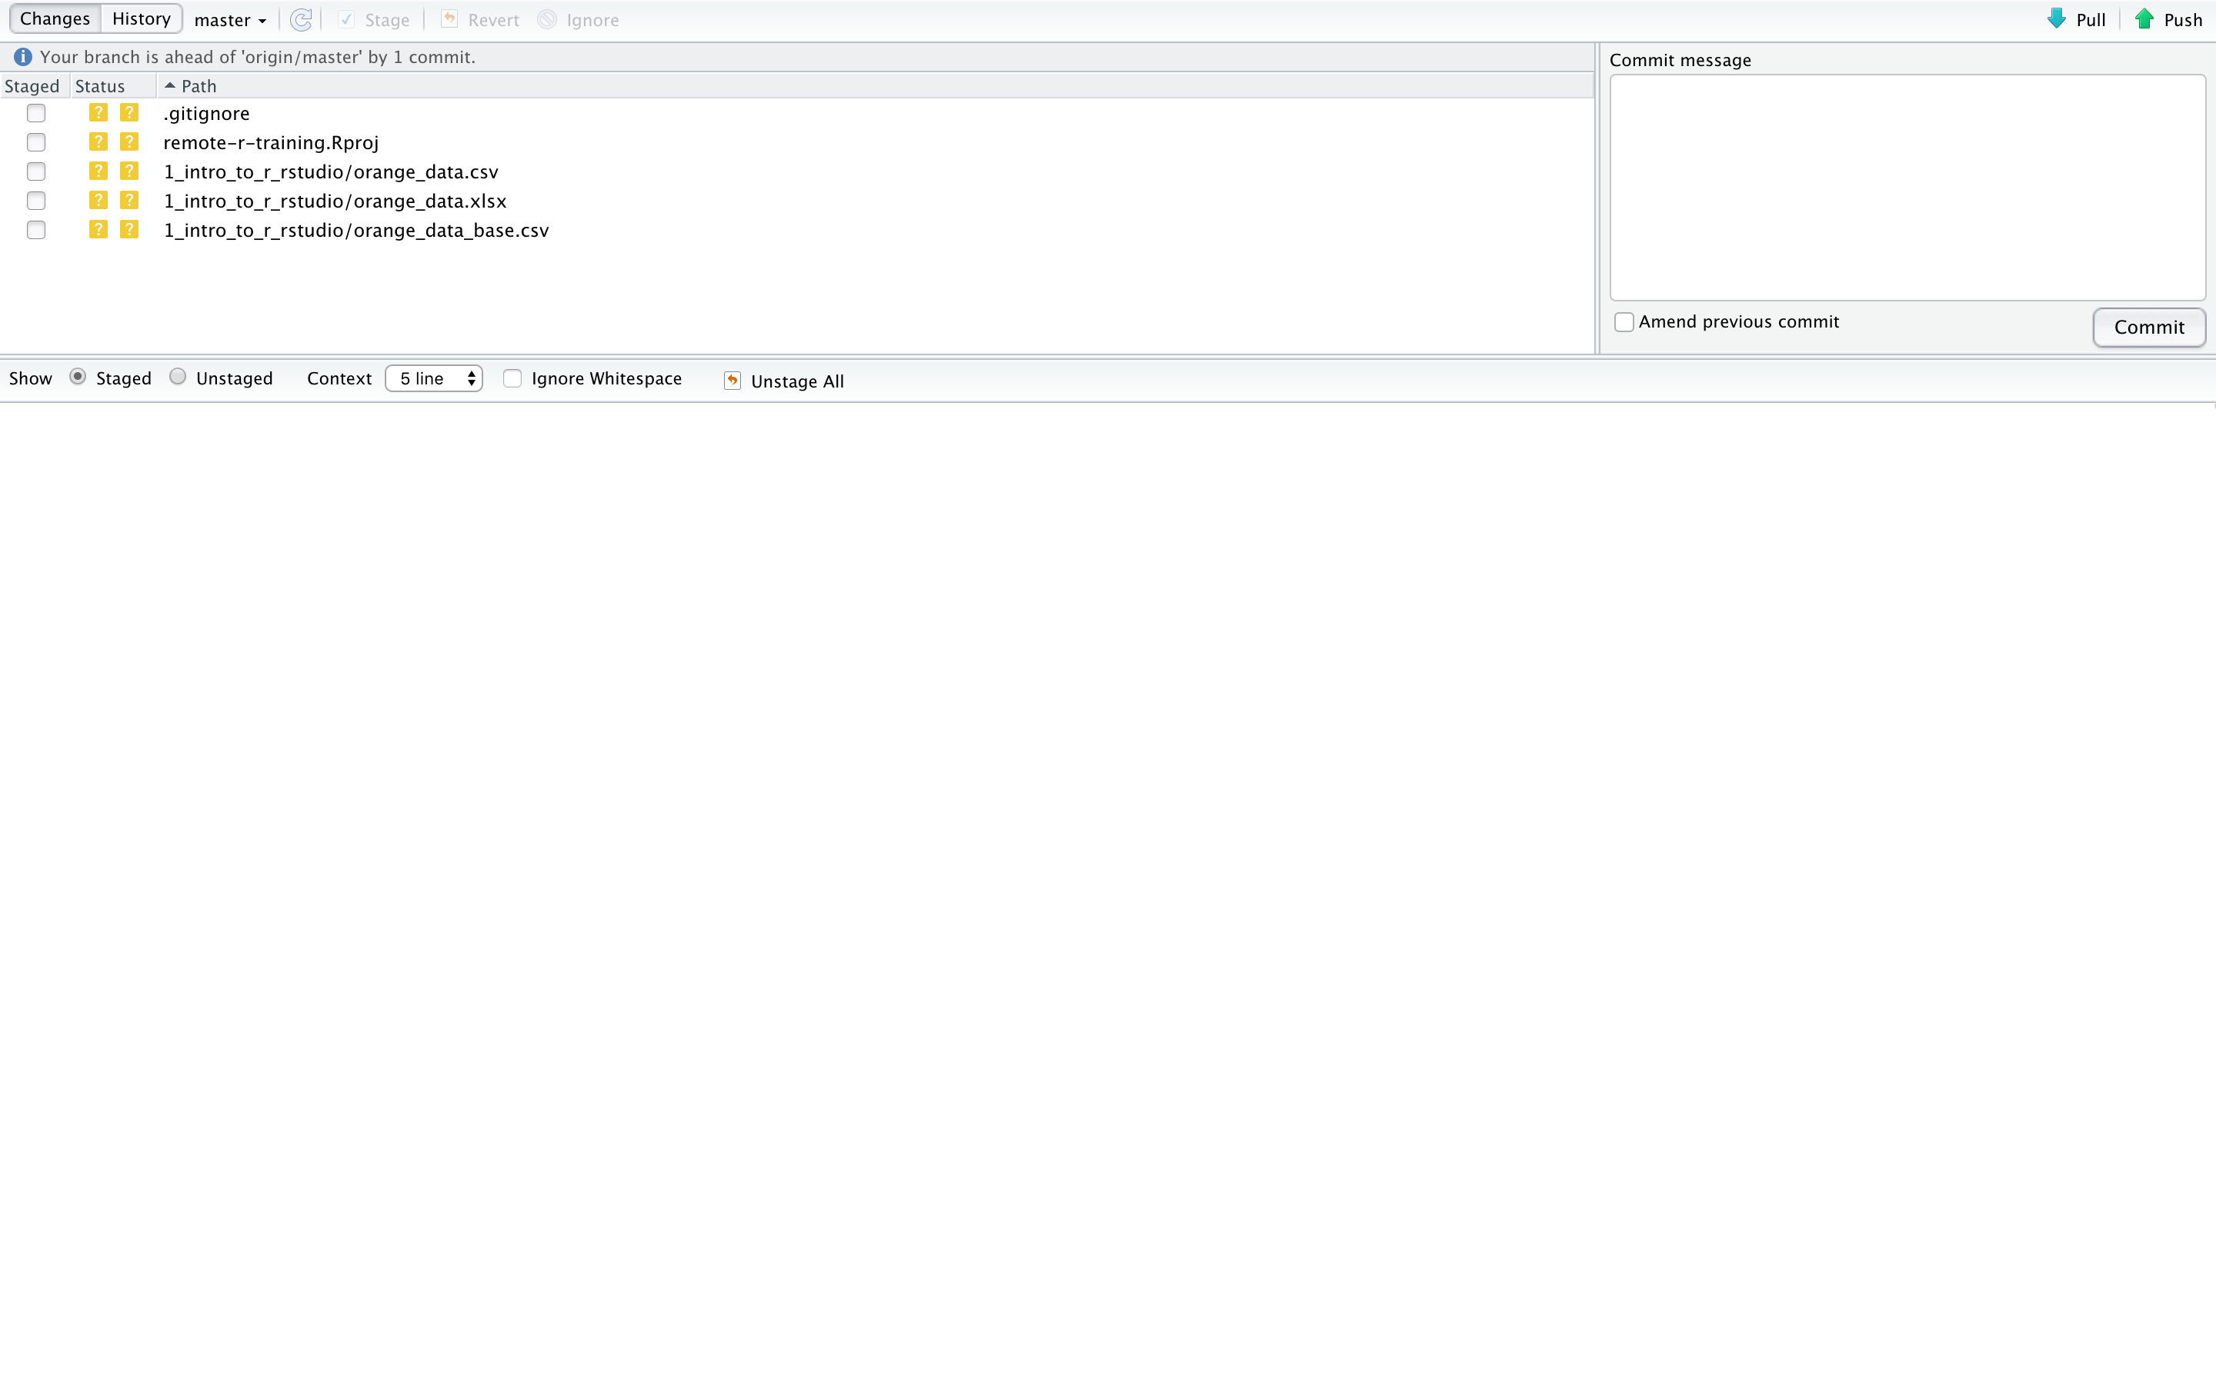

Slide 25
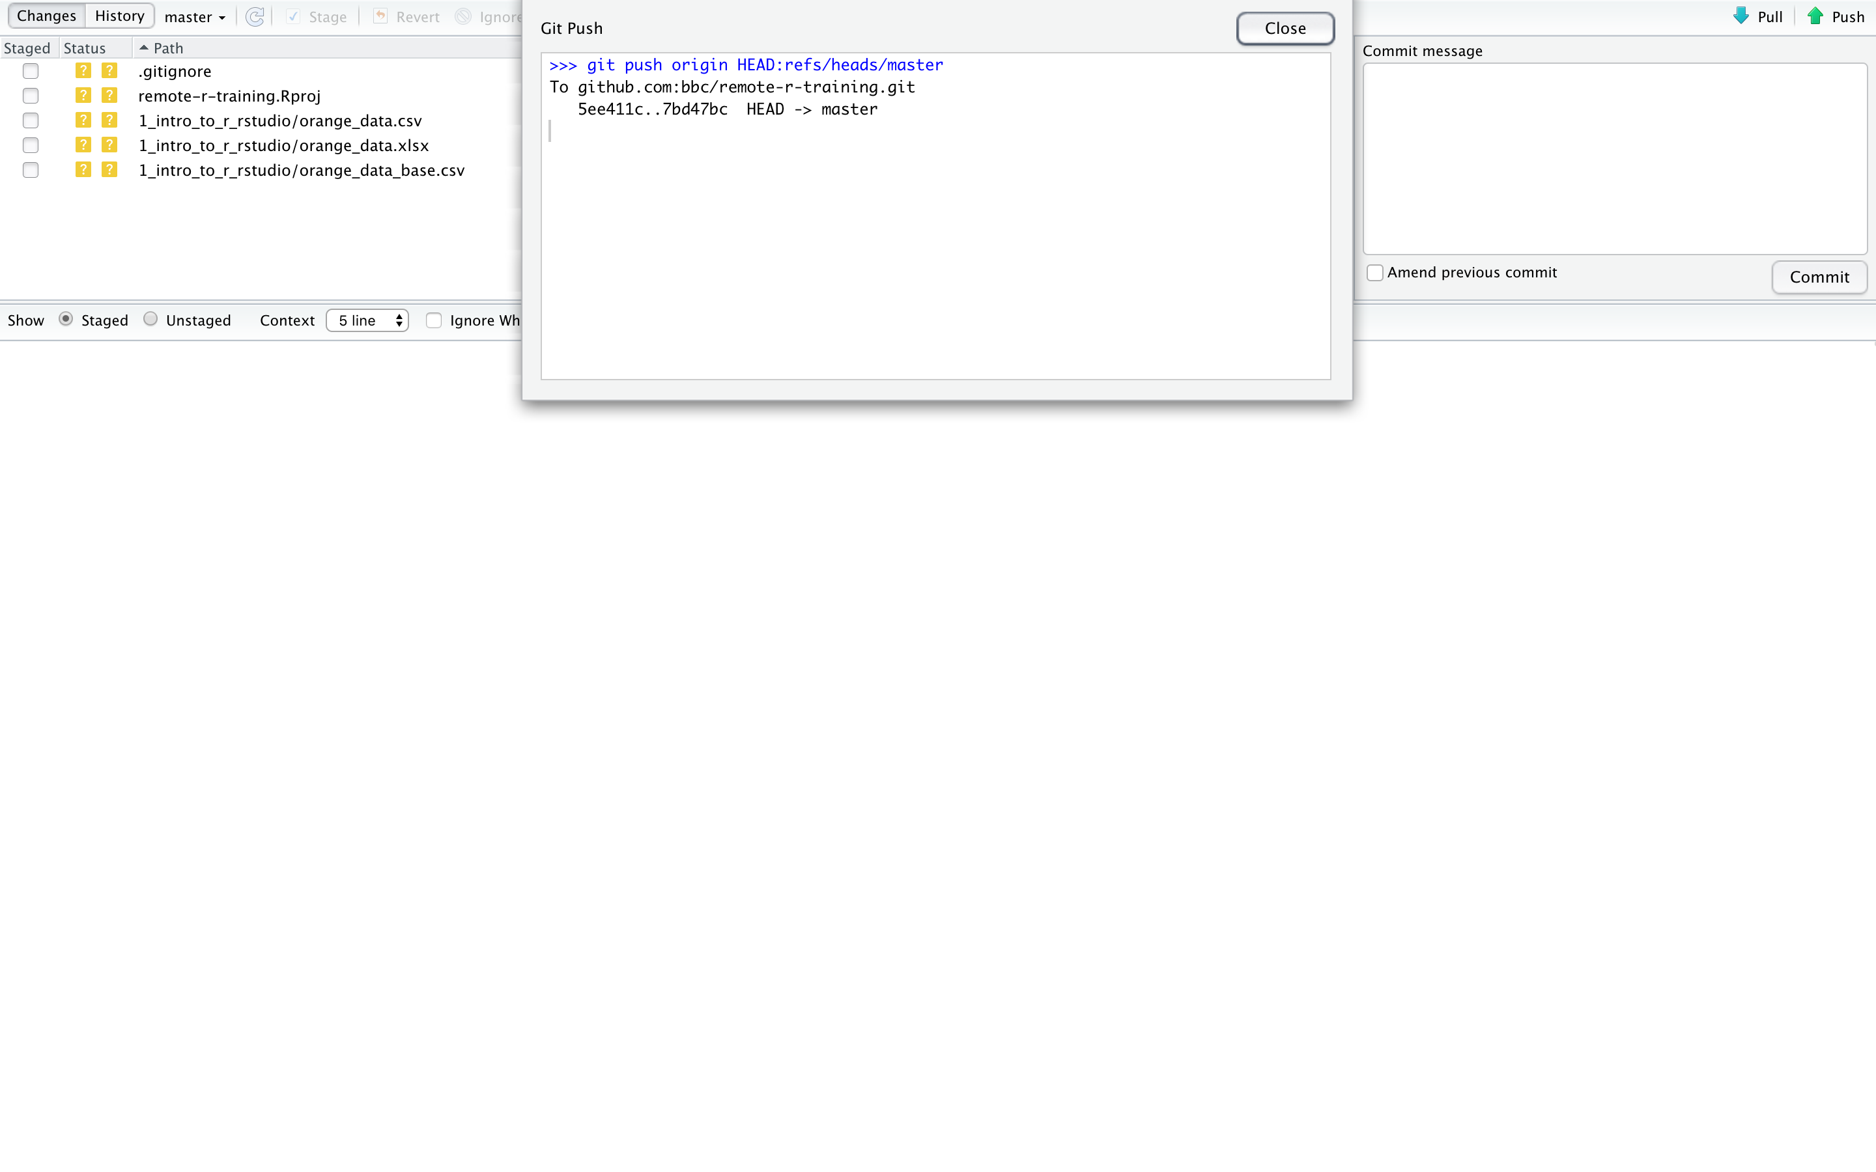

Slide 26
Resources

Slide 27
Useful links
RStudio info and tour video:
https://rstudio.com/products/rstudio/
RStudio keyboard shortcuts:
https://support.rstudio.com/hc/en-us/articles/200711853-Keyboard-Shortcuts
(also available under Tools → Keyboard Shortcuts Help)
Benchmarks of file input, output and storage in R:
https://edomt.github.io/File-IO-Storage/
Happy Git with R:
https://happygitwithr.com/
RStudio cheat sheets: https://rstudio.com/resources/cheatsheets/
R for Data Science:
https://r4ds.had.co.nz/introduction.html
Tidyverse Style Guide:
https://style.tidyverse.org/

